Slide 1
Welcome to
ELEC5650 Medical Electronics and E-Health
(15 credits)
Dr Paolo Actis
p.actis@leeds.ac.uk

Slide 2
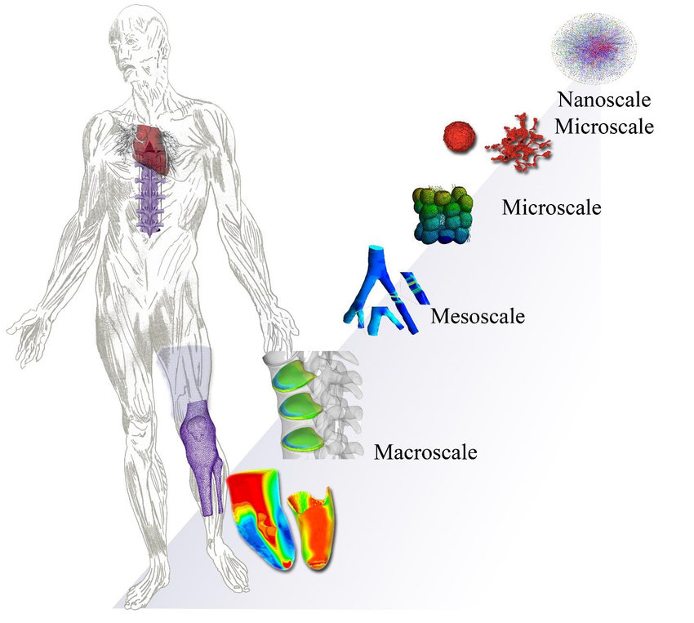
An electronics journey through the human body
Dernowsek et al, 2018, Biomechanics

Slide 3
Unit 1
DNA sequencing, protein biosensing, glucose sensing (including implantable sensors)
Dernowsek et al, 2018, Biomechanics

Slide 4
Unit 1
DNA sequencing, protein biosensing, glucose sensing (including implantable sensors)
Unit 2
Excitable cells, wearable sensors, signal processing,
Dernowsek et al, 2018, Biomechanics

Slide 5
What | When | Where
Lectures | Mon, 16-17 Wed 9-10 | Roger Stevens LT21 Mech Eng LTA
Lab sessions (optional) | Wed (13-14) or Thu (9-10) | B55
UNIT 1 Assignment (30%) | 27th Feb 12-14 | ELEC/SCAPE (Gradescope)
UNIT 2 Assignment (30%) | Week 24 | ELEC/SCAPE (Gradescope)
Group Presentation (40%) | Assessment week | TBD

Slide 6
Lab Sessions
An opportunity for you to complete the Labster Virtual Labs to complement you learning journey.
You can complete the Labster labs during the scheduled lab sessions or at any other time if you prefer.
Labster is a 3D laboratory training software. It delivers interactive, virtualised laboratory simulations across STEM and other subject areas to offer an immersive learning experience.

Slide 7
Schedule
Lecturer | Week | Topic
Actis | 14 Unit 1 | Mon: Intro
 |  | Wed: DNA sequencing
Actis | 15 Unit 1 | Mon: DNA Sequencing
 |  | Wed: Introduction to proteins
Actis | 16 Unit 1 | Mon: lateral flow devices
 |  | Wed: Protein biosensors
Actis | 17 Unit 1 | Mon: Electrochemistry
 |  | Wed: Electrochemical Sensors

Slide 8
Lecturer | Week | Topic
Actis | 18 Unit 2 | Mon: Recap Unit 1
 |  | Wed: Excitable Cells
Actis | 19 Unit 2 | Mon: Excitable Cells
 |  | Wed: Ion channels
Actis/Zhang | 20 Unit 2 | Mon: Action Potential
 |  | Wed: Recap Excitable Cells
Zhang | 21 Unit 2 | Mon: Physiological Signal Processing
 |  | Wed: Physiological Signal Processing
Zhang/Pensabene | 22 Unit 2 | Mon: Body Sensor Networks
 |  | Wed: Wearable devices

Slide 9
Lecturers
Dr Paolo Actis (Module Leader and Associate Professor of Bionanotechnology)
Dr Zhiqiang Zhang (Associate Professor of Body Sensor Network for Healthcare and Robotics)
Dr Virginia Pensabene (Associate Professor of Electronics and Biomedical Engineering)

Slide 10
Assignments (60%)
2 Gradescope Assignments
(one for each unit 30% each, together make 60% of total mark)
UNIT 1 Assignment: Tuesday 27th February 12-14
Unit 2 Assignment: Week 24
Multiple choice questions (12 questions, no negative marking)
Closed books: only written (or typed) notes allowed (2 pages A4)

Slide 11
Group Presentation (40%)
One group (4 students) presentation on a med-tech of your choice (10 min) and a signal processing task (5 min) (40% of total mark)
No submission required , only a 15-minute group presentation to be delivered during Assessment Week

Slide 12
Reading List
There is no reading list for this module.
We will provide all the reading material you need to meet the learning outcomes.
We expect you should research independently extra material (for example, from peer review journal articles or conference proceedings)

Slide 13
Tasks
Join a group of 4 students
(on the Module Minerva Page under Module Groups)
You will work together on a literature research project on a med-tech device of your choice (more details later) and on a signal processing task.
You will then deliver a 15-minute presentation on both tasks that will count for 40% of your final mark

Slide 14
Tasks
2. Familiarize with Labster
We will make extensive use of Labster labs
Labster is a 3D laboratory training software. It delivers interactive, virtualised laboratory simulations across STEM and other subject areas to offer an immersive learning experience.

Slide 15
Tasks
3. Please download Matlab on your computer as you will need it for the signal processing task from week 20
Info on how to download Matlab is under the Organization page on Minerva of the School of Electronic and Electrical Engineering

Slide 16
What questions do you have?

